Slide 1
Travelling Salesman Problem
Presented by: Pathan Mohammed Akram Khan 2023BCSE07AED041 B.Tech CSE (AI & ML)

Slide 2
Travelling Salesman Problem using Genetic Algorithm
Genetic Algorithm is an optimization technique
Inspired by natural selection (survival of the fittest)
Works with a population of solutions (routes)
Uses fitness function to evaluate solutions
Applies selection, crossover, and mutation
Produces best or near-optimal solution over iterations

Slide 3
Algorithm of Genetic Algorithm
Initial population (random routes)
Fitness = total distance (minimize)
Selection → choose best routes
Crossover → combine routes
Mutation → small random changes

Slide 4
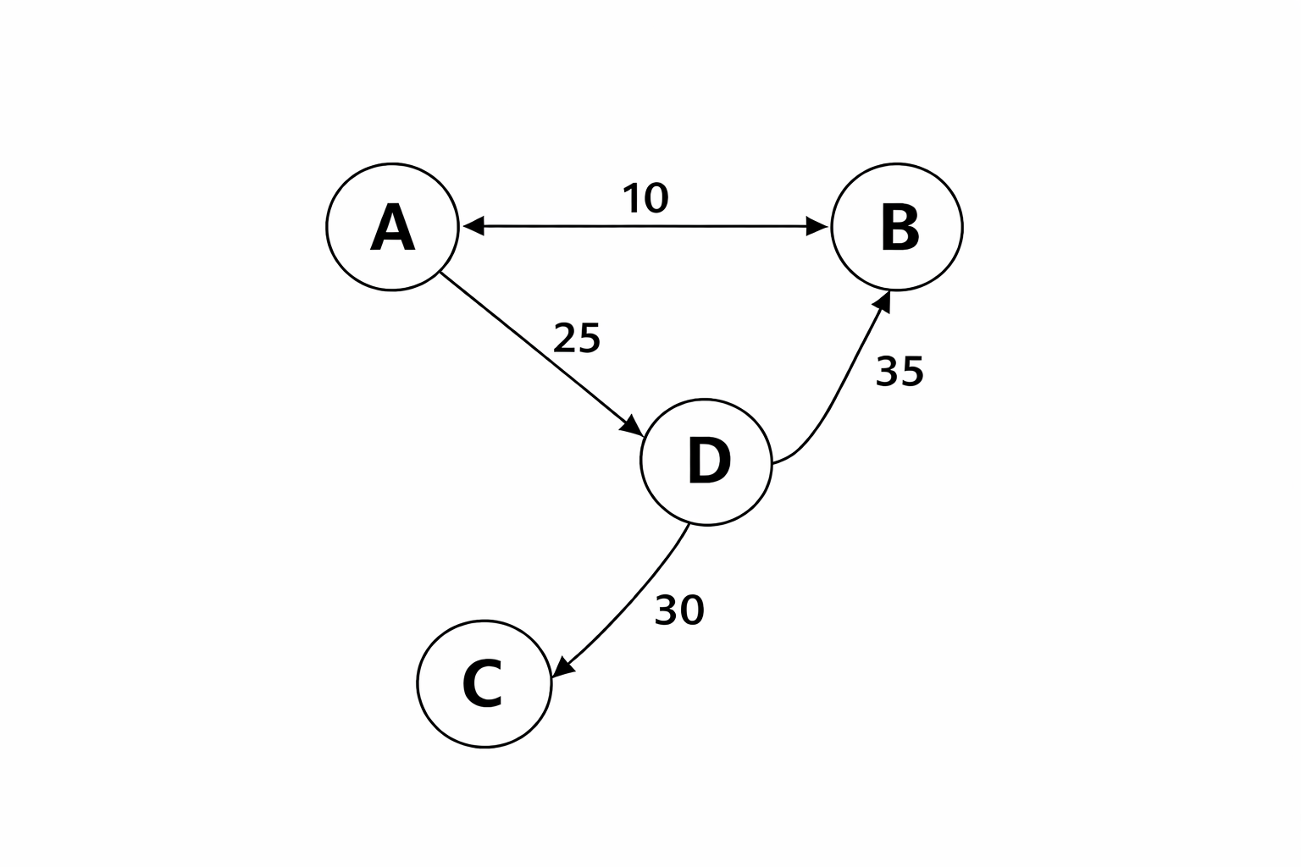
Working
Given route distances:
A–B = 10, A–D = 25, D–B = 35, D–C = 30
Initial Routes
A → B → D → C → A
A → D → B → C → A
A → C → D → B → A

Slide 5
Fitness
A–B–D–C–A = 10 + 35 + 30 + 15 = 90
A–D–B–C–A = 25 + 35 + 30 + 15 = 105
A–C–D–B–A = 15 + 30 + 35 + 10 = 90
Selection
Choose best routes (minimum distance = 90)

Slide 6
Crossover & Mutation
New route: A → B → D → C → A
Best Route: A → B → D → C → A Minimum Distance = 90

Slide 7
Travelling Salesman Problem Using Ant Colony Optimization
Ant Colony Optimization is a metaheuristic optimization algorithm
Inspired by real ants finding shortest paths using pheromones
Uses artificial “ants” to explore possible solutions
Paths with more pheromone are more likely to be chosen
Shorter paths get stronger pheromone updates
Repeated iterations lead to best/near-optimal solution

Slide 8
Algorithm for ACO
Initialize pheromone
Place ants
Construct routes
Evaluate distance
Update pheromone
Repeat
Output best path

Slide 9
Working
Start ants from city A
Ants choose next city using pheromone + distance
Routes are formed, for example: A → B → D → C → A A → D → C → B → A
Calculate total distance of each route
Compare all routes

Slide 10
Shortest route gets more pheromone
Repeat process multiple times
Best route becomes strongest
Best Route: A → B → D → C → A Minimum Distance = 90

Slide 11
Comparison
ACO is better for:
Path problems (like TSP, routing)
Faster convergence
Uses pheromone → more directed search
GA is better for:
General optimization problems
Large and complex search spaces
Provides more diverse solutions

Slide 12
Conclusion
Both ACO and GA are powerful optimization techniques
ACO is more effective for path-based problems like TSP
GA is flexible and works for a wide range of problems
ACO converges faster and gives better shortest path results
Both provide near-optimal solutions
ACO is preferred for TSP, while GA is suitable for general
optimization problems

